Slide 1



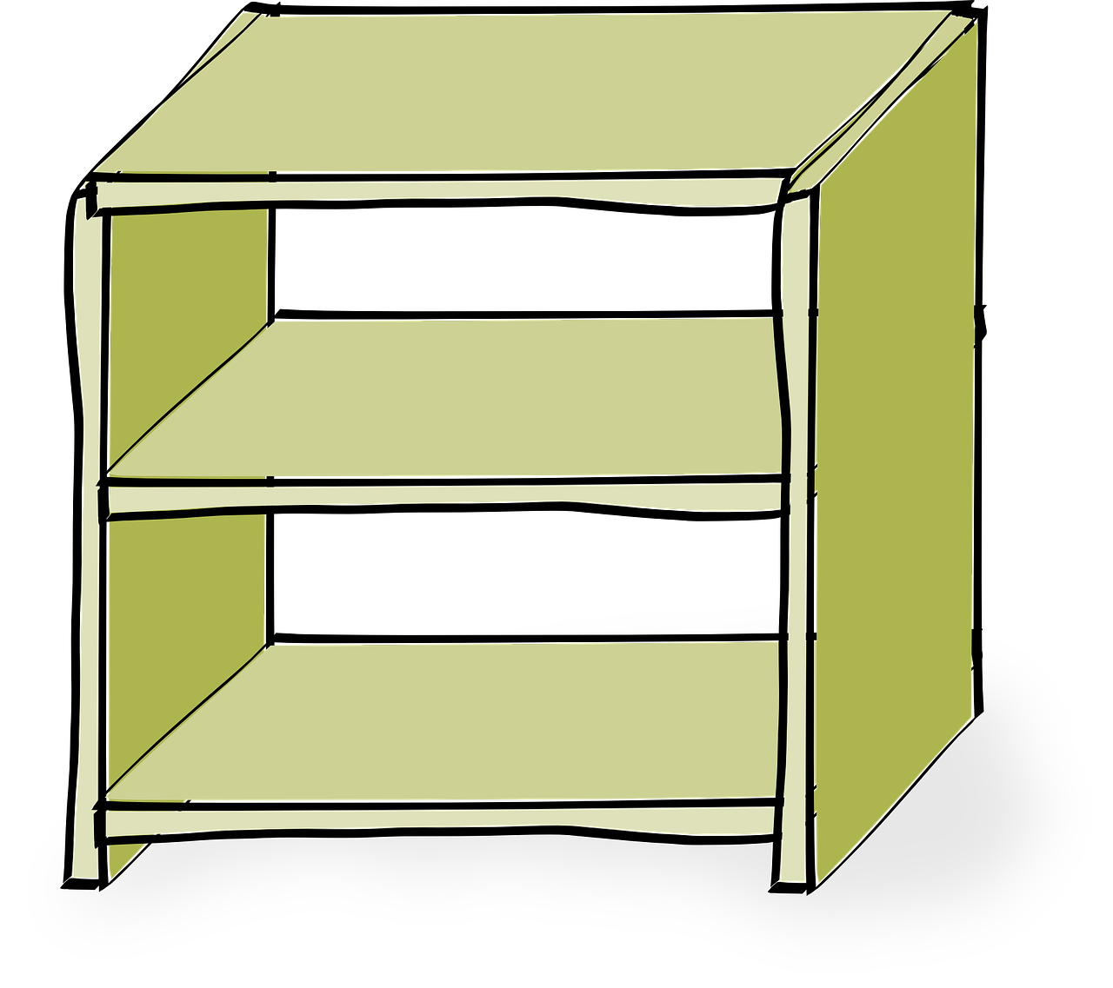

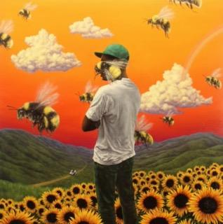

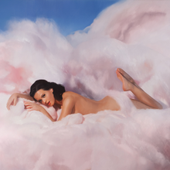
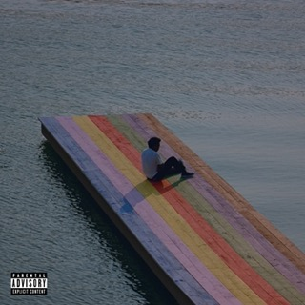
First Option: Record Player + Lyrics + Visual

Slide 2





First Option: Record Player + Lyrics + Visual
“California girls
We're unforgettable
Daisy Dukes, bikinis on top
Sun-kissed skin so hot
We'll melt your popsicle”

Slide 3






Second Option: Maze Game
use your arrow keys to move…
Avoid enemies and collect food…
You Did It!

Slide 4
Second Option: Maze Game
Certain amount of steps will be allowed.
Sound effects for moving, eating, meeting an enemy, and completing maze.
May add an item you must collect before completing.
May add different levels of difficulty.
When encountering an “enemy” you must solve a puzzle. (i.e. drag shapes to matching holes)

Slide 5
Third Option: Interactive Global Warming Tracker
https://climate.nasa.gov/news/2854/time-lapse-watch-glaciers-rise-fall-in-thousands-of-years-per-second/
https://earth.google.com/web/@61.05987082,-147.05927869,5a,22434d,35y,-23h,70t,0r/data=CjYSNBIgM2ZkOTk3YWI0Njk4MTFlYTlkZWUyZGUyNWIyYWZmNjkiEGNvbHVtYmlhLWdsYWNpZXI
https://www.weforum.org/agenda/2019/11/arctic-ice-melting-time-lapse-video/

Slide 6
Fourth Option: Song Maker
https://www.incredibox.com/demo/

